Slide 1
WELCOME TO ASER DISSEMINATION
CUM DISTRIBUTION OF CERTIFICATES
AT
DIET KAMKI, WEST SIANG
Date 17th March
2023

Slide 2


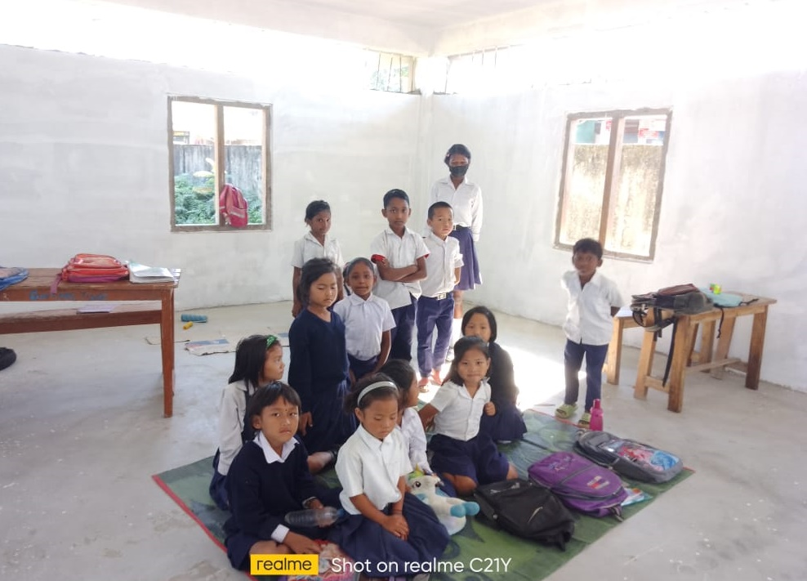

Annual Status of Education Report (Rural) 2022
Arunachal Pradesh - State findings

Slide 3

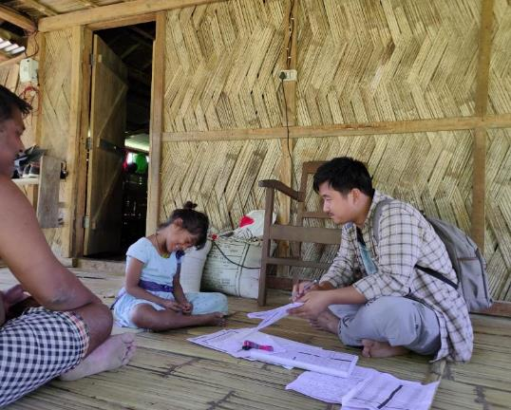
CONTENTS
About ASER and coverage
Enrollment patterns
Learning levels
Tuition trends
School facilities and RTE indicators
Concluding thoughts

Slide 4

About ASER and coverage
WHY: Are children enrolled in schools?
Can they read? Can they do basic arithmetic?
What is the status of basic school facilities?
Coverage in ASER 2022 | Arunachal Pradesh | India
Districts reached | 13 | 616
Villages surveyed | 376 | 19,060
Households surveyed | 5,320 | 3,74,554
Children surveyed (age 3-16) | 9,148 | 6,99,597
Children tested (age 5-16) | 6,293 | 5,37,425
Schools surveyed | 238 | 17,002
Partner organizations | 13 | 591
WHERE: Sampling using 2011 Census (rural)
30 villages randomly selected in each district
20 households randomly selected in each village
Children aged 3-16 surveyed
Children aged 5-16 assessed
Largest govt school in village with primary sections visited
WHAT:
Household survey in rural areas
One-on-one assessment with each child
Basic reading, arithmetic and English for all 5-16 year old children in sampled households
WHO: 13 partners including DIETs, and private colleges/universities
WHEN: Survey in October-December 2022
1

Slide 5

Slight shift towards govt schools. Attendance of
children moderate
Universal enrollment: Almost all children (97%) aged 6-14 years are enrolled in school
Chart 1: % Children age 6-14 enrolled in govt schools
Table 1: % Children and teachers present in govt schools on day of survey
 | Student attendance |  | Teacher attendance
 | India | ArP | India | ArP
Primary schools | 72.9 | 76.5 | 86.8 | 78.9
Upper primary schools | 87.5 | 75.9 | 87.5 | 75.4
Students’ attendance in ArP is higher than the national average in primary schools but lower in upper primary.
Almost 2 out of 3, 6-14-year-old children are enrolled in government schools
Slight increase in govt school enrollment from 2018 to 2022
2

Slide 6
Reduction in proportion of not enrolled children in the age group
of 11-14 and 15-16, both boys and girls from 2006
Chart 2: % Children not enrolled in school - by gender: age 11-14 & 15-16. 2006-2022
Table 2: % Children aged 3-5 in anganwadi and those not enrolled. 2018-2022
Age | Anganwadi |  | Not enrolled
 | 2018 | 2022 | 2018 | 2022
Age 3 | 35.2 | 42.7 | 39.8 | 35.6
Age 4 | 25.7 | 29.8 | 18.3 | 21.7
Age 5 | 17.1 | 13.5 | 6.8 | 10.8
We see that the % of children enrolled in Anganwadi’s has increased for 3 and 4 year olds when comparing data of 2022 to that of 2018. On the other hand, we also see that there has been an increase in the % of 4 and 5 years old who are not enrolled when comparing data of 2022 to that of 2018.
ArP has shown a big change over the years in not enrolled children, especially in older age groups
Girls not enrolled in school fell to 6.4% in 2022 from 20.0% in 2006.
3

Slide 7
ASER reading tool
Each child is assessed one on one. The child is marked at the highest level that s/he can reach comfortably.
Different children are assessed using different samples.
The ASER reading tasks are progressive in nature.
4

Slide 8

Reading levels decline in Std III
Chart 3: % Children in Std III-VIII in government schools who can read Std II level text. 2018 and 2022
Table 3: % Children in Std III-VIII in government schools who can read Std II level text. By gender. 2018 and 2022
% of the children in Std III who could read a Std level II text in 2022 as compared to in 2018 decreased significantly.
There has been an increase in the proportion of children at story level for Std V and VIII.
Effects of COVID school closure can be evidenced amongst both boys and girls in Std III and Std VIII girls. However, boys in Std VIII seems to be performing better in 2022
5

Slide 9
Gap in reading levels between government and private
schools
Chart 4: % Children in Std III who can read a Std II level text. By school type. 2014-22
Chart 5: % Children in Std V who can read Std II level text. By school type. 2014-22
Massive gap persists in performance of children in government and private schools across grades.
Only 3.5% Std III children in government schools are at grade level.
6

Slide 10
ASER arithmetic tool
Each child is assessed one on one. The child is marked at the highest level that s/he can reach comfortably.
Different children are assessed using different samples.
The ASER arithmetic tasks are progressive in nature.
Expected by Std II/III
Expected by Std III/IV
7

Slide 11
Slight drop in arithmetic levels of grade 5 and 8 from2018
Chart 6: % Govt school children in different grades who can do division. 2018 and 2022
Table 4: % Govt school children in Std V&VIII who can do division. By gender. 2018 and 2022
In 2022, 19.5% of the children in Std V were able to do division as compared to 22.1% in 2018. Similarly for children in Std VIII, we see that 40.2% of the children were able to division in 2022 as compared to 42.6% in 2018.
There has been a sharp decline in the % of girls in Std VIII who were able to do division in 2022 as compared to in 2018. For boys in Std VIII, we see that more of them were able to do division in 2022 as compared to in 2018.
8

Slide 12
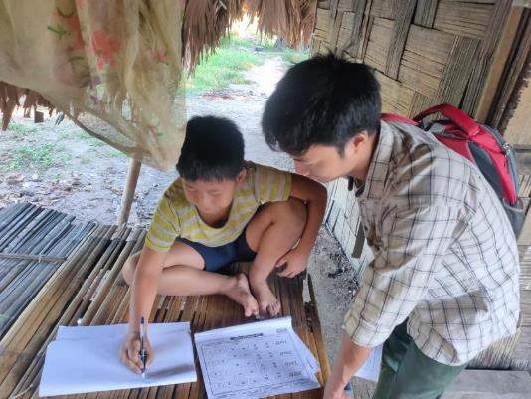
Private outperforms government in arithmetic
Chart 7: Govt vs Pvt: % Children in Std III who can do at least subtraction. By school type. 2014-22
We can see that children in Std III in private schools seem to be faring better in their ability to do division as compared to Std III children in govt schools.
9

Slide 13
English reading and comprehension levels
96.4%
93.1%
Table 5: English reading and comprehension in Std III-VIII. 2022
Std | % Children who can read sentences | Of those, % children who can tell the meaning of sentences
III | 18.7 | 64.3
IV | 34.9 | 75.9
V | 47.9 | 77.8
VI | 60.1 | 85.8
VII | 69.6 | 89.8
VIII | 76.4 | 87.8
Std V
As children progress to higher grades, their ability to read and comprehend sentences can be seen improving.
80.1%
47.9%
10

Slide 14
Incidence of paid tuition is almost the same as national average
Chart 8: % Children in Std I-VIII who take paid tuition classes. 2022
Chart 9: % Children in Std I-VIII who take paid tuition classes. By school type. 2014-22
Private tuition is increasing over the years. Both govt and pvt school students are likely to take paid tuitions.
11

Slide 15

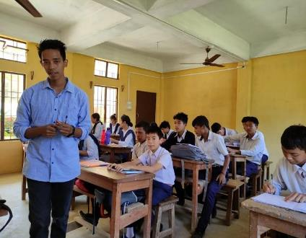
School facilities and RTE indicators over time
Table 6: The largest govt primary school in the village is visited, and information is collected on RTE indicators and other school facilities based on observation on the day of visit.
% Schools with | 2010 | 2018 | 2022
Mid-day meal served on day of visit | 47.1 | 36.2 | 51.3
Drinking water available | 53.2 | 44.7 | 62.0
Useable toilet | 25.3 | 50.0 | 60.1
Separate, useable girls’ toilet | 12.0 | 28.2 | 43.6
Electricity connection |  | 62.8 | 79.3
Playground | 58.9 | 55.4 | 76.0
Over the years, school infrastructure in the state has improved significantly. However, more needs to be done to ensure that a higher percentage of useable girls’ toilets are available.
12

Slide 16
Big push is needed to reach foundational literacy-numeracy goals
All India figures suggest that from 2014 to 2018, there had been a gradual improvement in both basic reading and math. However this was interrupted by the pandemic years.
In 2022, about 36% of all children in Grade III were at ‘grade level’ in math & about 11% in reading. This means that most children:
need urgent help in acquiring foundational skills in literacy and numeracy
require a big push in early grades to help children reach NIPUN Bharat goals in the next few years.
Grade III
COVID years
By the end of Grade II in India, children are expected to be able to read a simple text fluently and also be able to do basic operations like subtraction. Hence, it is possible to use ASER data as a ‘proxy’ for the proportion of children who are at ‘grade level’ by the time they have reached the middle of the school year in Grade III.
13

Slide 17
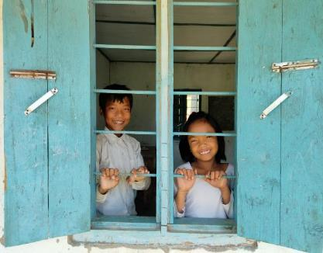
Concluding thoughts
In Arunachal Pradesh, enrollment of children seems to be stable in govt schools from 2018 onwards.
Great deal of effort is being made towards achieving goals for the foundational stage (age 3-8) as outlined in the NEP 2020.The momentum must be maintained.
Big changes in practice & appropriate activities & high effort needed in the classroom if all children are to achieve basic foundational literacy & numeracy by Std III by 2025.
Urgent need for “catch up” in Std IV-VIII to build foundational skills.
14

Slide 18
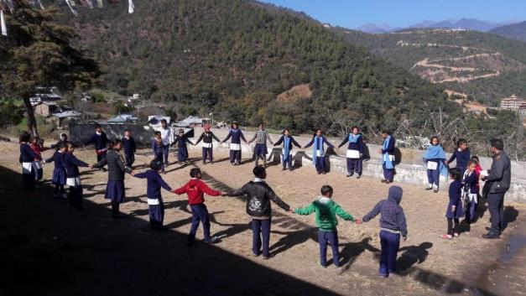





Contact information
For more information:
See asercentre.org for all ASER reports
See pratham.org for how learning can be improved.
Contact us at:
contact@asercentre.org
info@pratham.org
saveri@pratham.org
Suraj.Das@pratham.org
shivlal.sharma@pratham.org
Ms. Saveri Kulkshreth – Contact No. 9413076623
Mr. Sarbeswar Das – Contact No. 8638390105
Mr. Shivlal Sharma – Contact No. 9774647343

